Slide 1
ARRAYS IN C
By
SUBHRANU SWAIN

Slide 2
What is Array? And what is need of array?
Under one variable name we can store more than one data items. All data are of one datatype. (subscript operator)
(if int only integer no float)
data_type array_name [size_of_array];(//declaration).
(EX:- int arr [60];)
If we take only (int a;) it will take 2 or 4 bytes of memory.
But if we take (int a[60];) it will take 2*60 or 4*60 according to the data type.
int a[ ]; int a[-5]; int a[11/2]; (wrong), int a[2+2]; int a[10/2];
int a[10*2];(write)
Defination:- Array is a variable which store more than one values of
same datatype in a continous memory location.

Slide 3
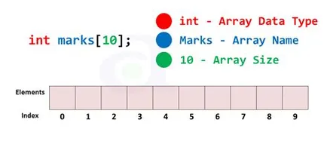
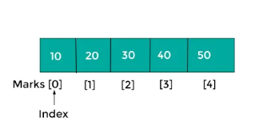

Slide 4
Some basics about an array.
Access the Elements of an Array:
​int arr[] = {25, 50, 75, 100};​
printf("%d", arr[0]);​​
// Outputs 25
​Change an Array Element:
​int arr[] = {25, 50, 75, 100};​
arr[0] = 33;
​​printf("%d", arr[0]);
​​// Now outputs 33 instead of 25​
Loop Through an Array:​
int arr[] = {25, 50, 75, 100};​
int i;​​for (i = 0; i < 4; i++)
{​
printf("%d", myNumbers[i]);
​}​
//output 25 50 75 100​

Slide 5
TYPES OF ARRAY
1. One dimensional array(1D-array).
2. Multi-dimensional array(2D,3D array etc.).

Slide 6
1D-Array
#include<stdio.h>
int main() OUTPUT: Enter the elements in array: 12
{ 45
int a[5],i; 56
printf("Enter the elements in array: "); 67
for(i=0;i<=4;i++) 78
{ Arrary elements: 12 45 56 67 78
scanf("%d",&a[i]);
}
printf("Array elements: ");
for(i=0;i<=4;i++)
{
printf("%d",a[i]);
}
return 0;
}

Slide 7
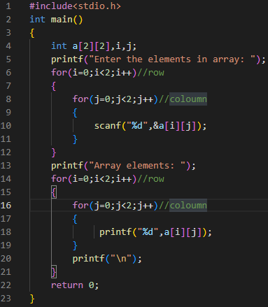
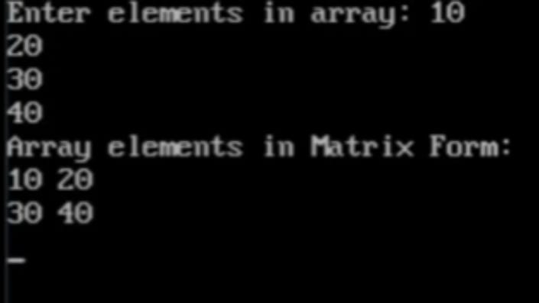
2D-Array
In this type of array we print the elements in matrix form.
Example:-

Slide 8
THANK YOU

